Slide 1
The Life and Times of Norm Tarowsky

Slide 2
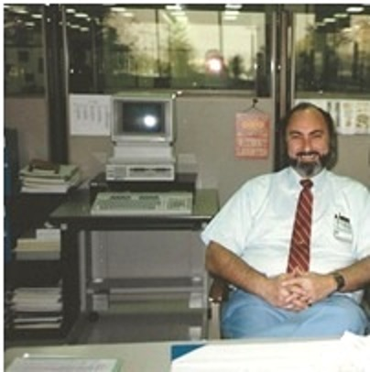
Norm at work a long time ago

Slide 3
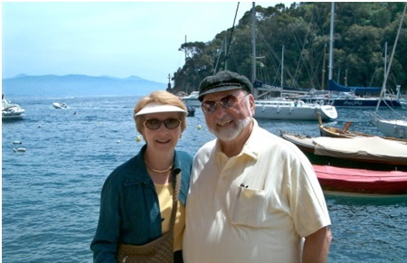
Norm & Dorothy in Portofino

Slide 4
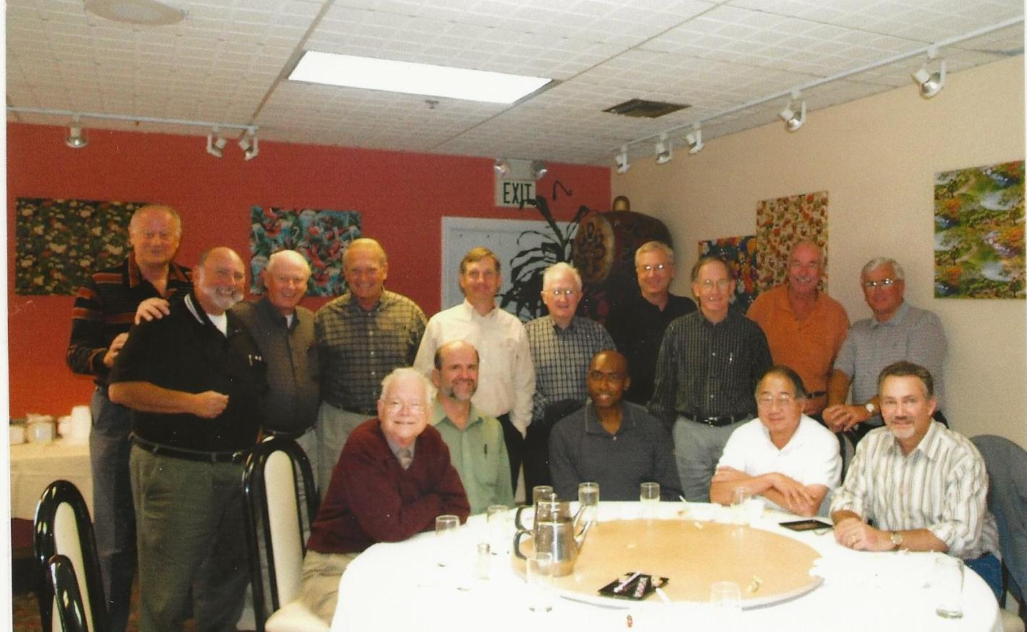
5-Bs Luncheon Group; October 28, 2005
Standing (l – r) Dick Kern, Norm Tarowski, David Evans, Stan Gage, Bill Majkut, Bob Picha, Bob Steward, Richard Lira, Gary Ruppel, Bill Franks. Seated (l – r) Walt Heinzer, Rich Burns, George Willis, Ed Aoki, Jeff Schnur.

Slide 5
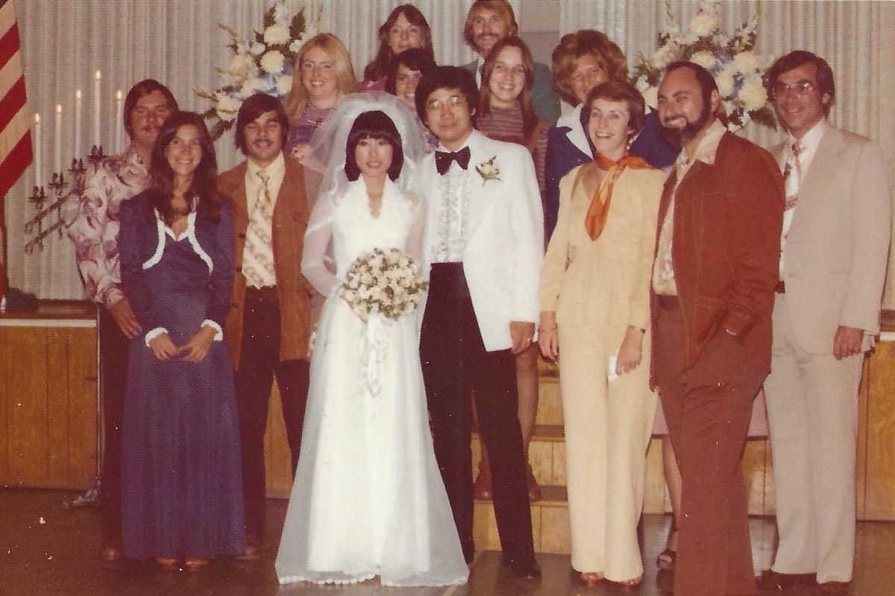
High Volume display group at Sam Yu's wedding

Slide 6
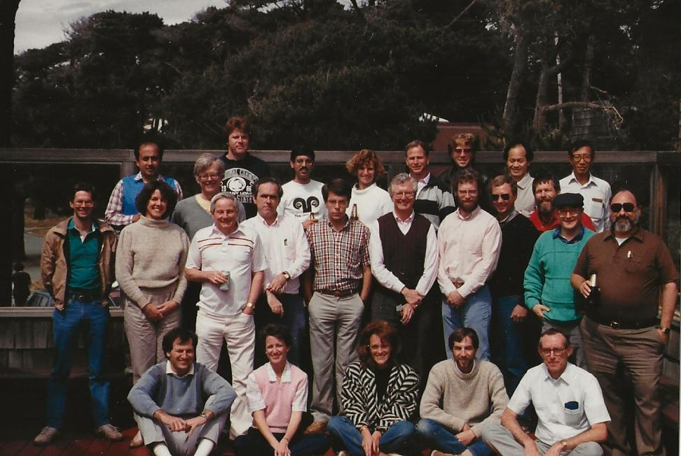
HP Class including many OED and MSD members

Slide 7
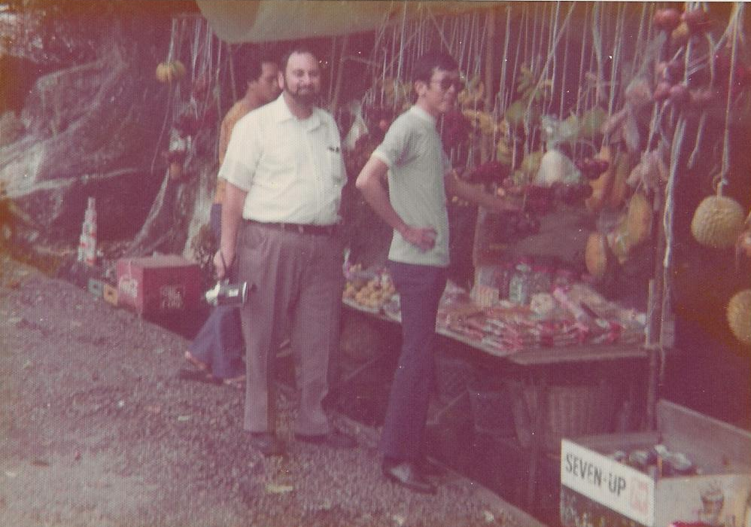
Norm and Albert Shen, shopping for Durian in Penang

Slide 8
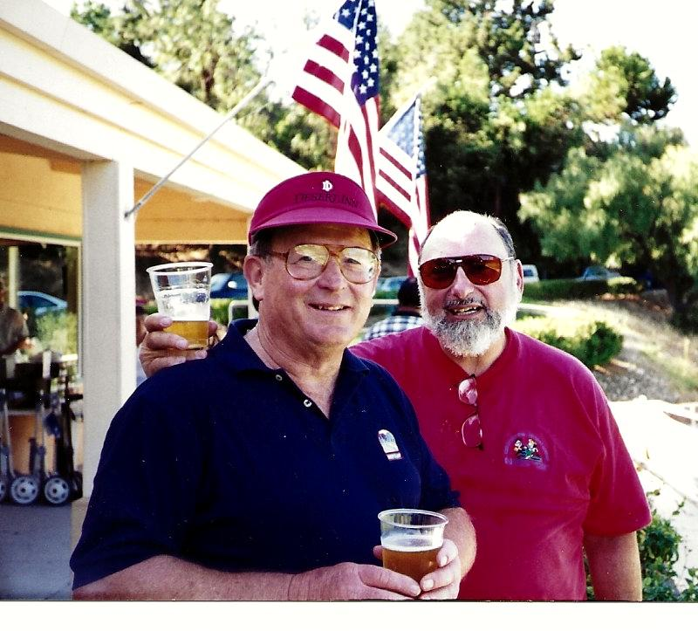
Norm and Bob Zettler at Picha-Boo Golf (Bob Picha’s MSD/OED) Tournament.

Slide 9
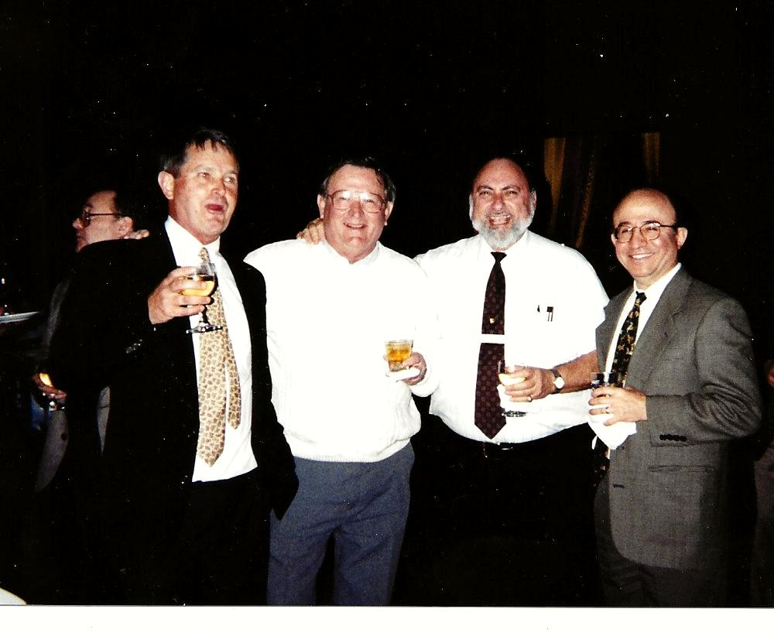
Norm with Dick Lamborn, Zettler and Ted Krevanian

Slide 10
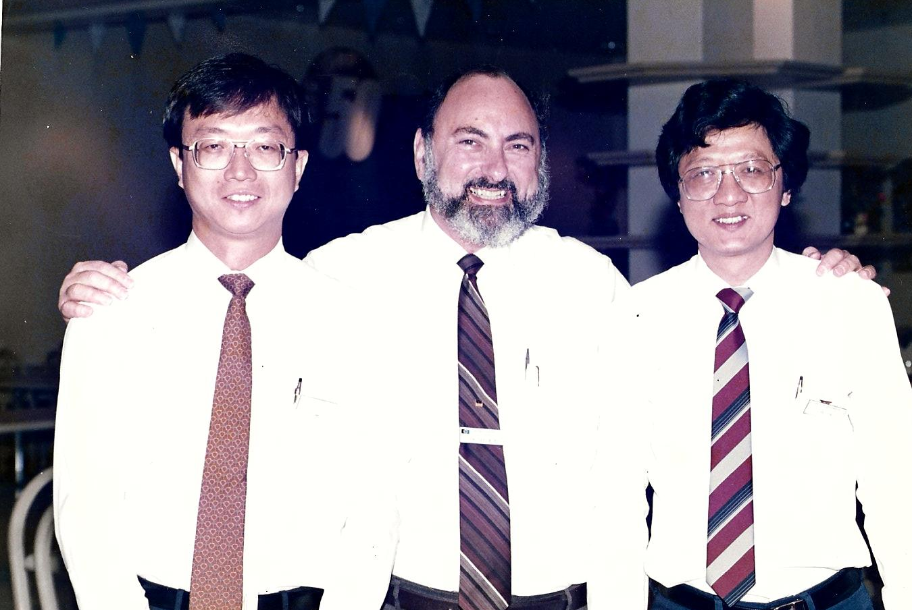
Norm with Bian Ee Tan and John Yew in Singapore

Slide 11
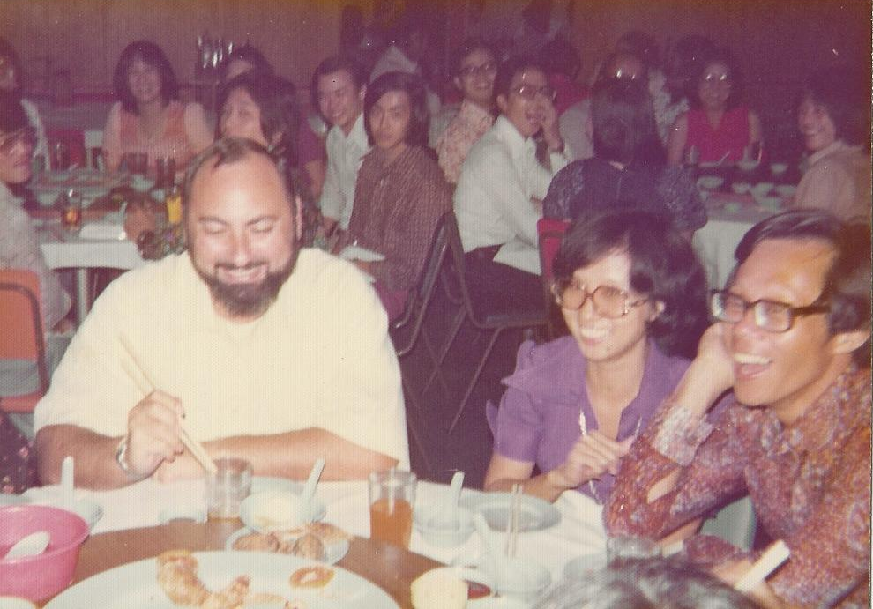
Norm with Nikki and Ong Keok Teng in Penang

Slide 12
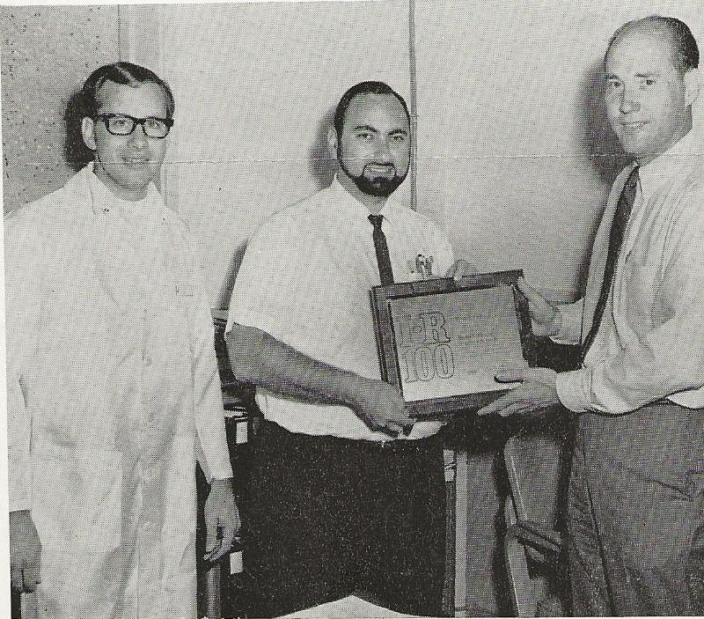
Industrial Research Magazine, 1968 IR-100 Award, for a clever stripline PIN diode. (l – r) Floyd Bishop, Norm Tarowski, Don Smith, HPA Division Mgr.

